Slide 1
(EQX) Compiler

Slide 2
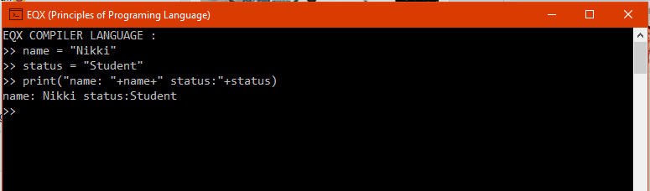
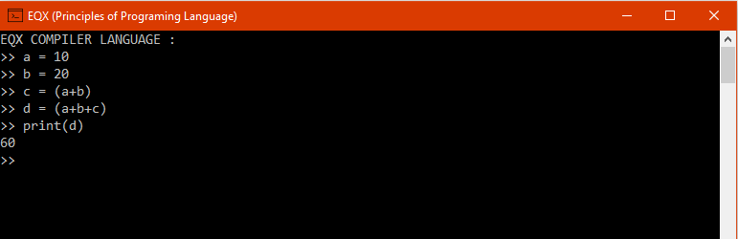
INTRODUCTION
EQX Compiler has the analysis stage (front end) which consists of the Lexical, Syntax and Semantic.

Slide 3
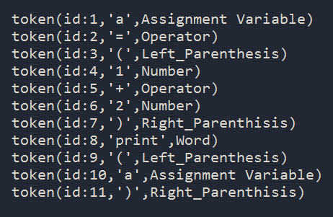

Lexical Analysis
Lexical analysis is the first phase of a compiler. It takes the modified source code from language preprocessors that are written in the form of sentences. The lexical analyzer breaks these syntaxes into a series of tokens, by removing any whitespace or comments in the source code.

Slide 4
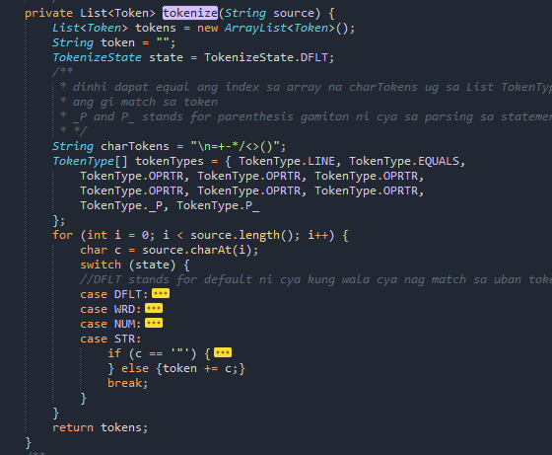
Lexical Analysis
A List of Token
Code
Break into
By using this process

Slide 5
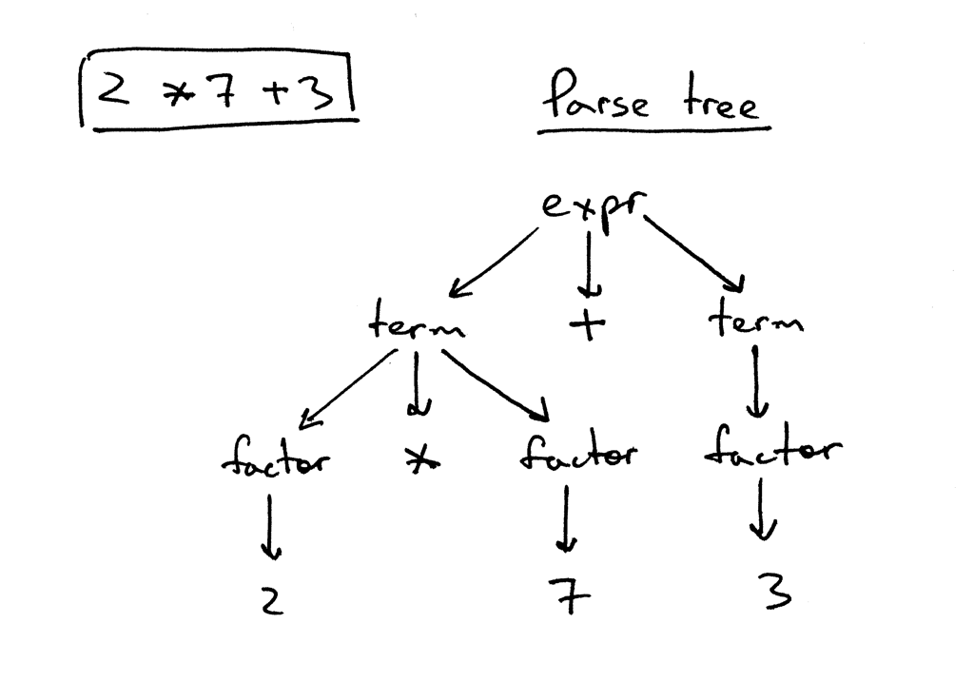
Syntax (Parser) Analysis and Semantic (MEANING) Analysis
Ex.
Semantic

Slide 6
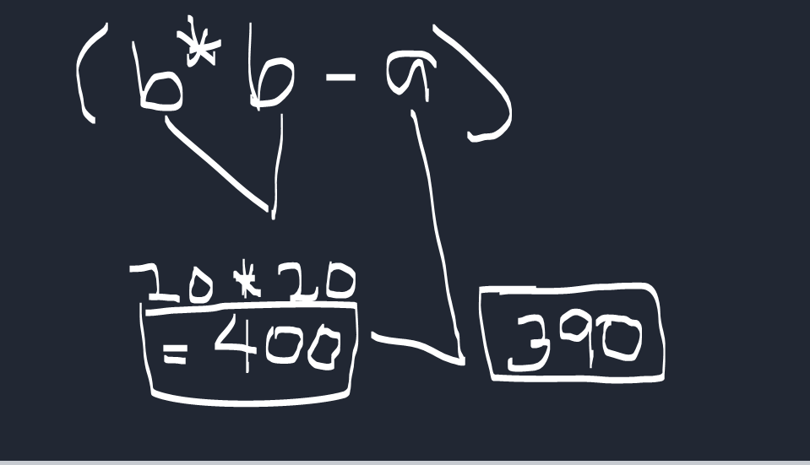
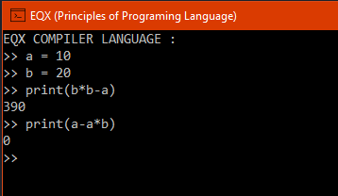

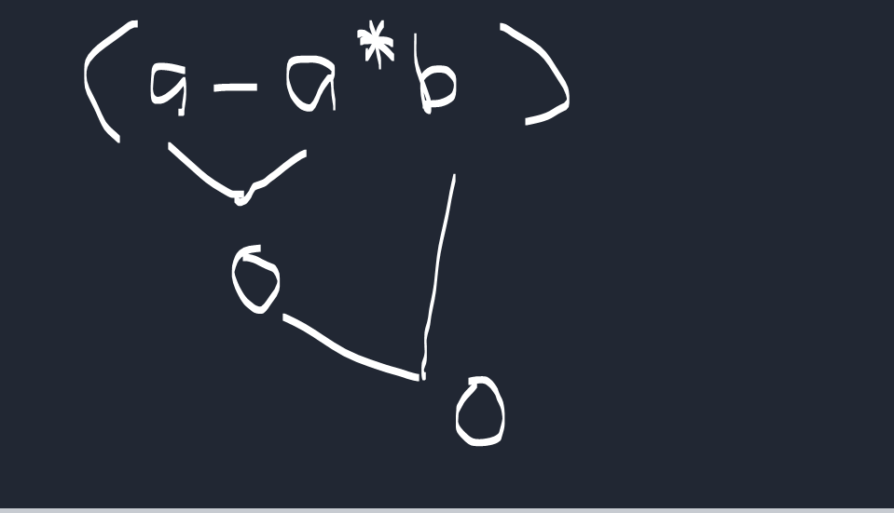
Syntax (Parser) and Semantic (MEANING) Analysis
Syntatic Analysis or creating parse tree in this process we implement derivation from left-to-right and it is called the left-most derivation
Output No. 1
Output No. 2

Slide 7
Syntax (Parser) and Semantic (MEANING) Analysis
Semantic analysis is the process of relating syntactic structures, from the levels of phrases, clauses, sentences and paragraphs to the level of the writing as a whole, to their language-independent meanings.
Output No. 1
Output No. 2

Slide 8
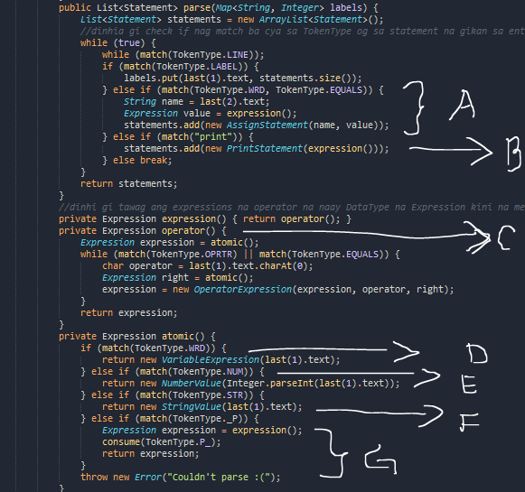
Syntax (Parser) and Semantic (MEANING) Analysis
A. This Parse is for Assigning Variables if the parse match the word(“variable name”) with equals(“=”)
B. Print and execute the statement of the all gathered expressions.

Slide 9
Syntax (Parser) and Semantic (MEANING) Analysis
C. Atomic functions starts computations, concat and assigning of value to a variable
Ex. (left EXPRESSION , 3)
(OPERATOR, +)
(right EXPRESSION, 5)
Or
Ex.
(left EXPRESSION, a (stands for variable))
(OPERATOR,+)
(right EXPRESSION, 5)

Slide 10
Syntax (Parser) and Semantic (MEANING) Analysis
ATOMIC FUNCTION ()
D. If the expression is contains a word or a variable then the atomic function call the Variable expression
Ex. b = (a+5) since ‘a’ is the left Expression therefore the value of a is being call

Slide 11
Syntax (Parser) and Semantic (MEANING) Analysis
ATOMIC FUNCTION ()
E. If the expression is contains a NUMBER then the left expression set as a number
Ex. b = (12+a) then 12 is an Integer

Slide 12
Syntax (Parser) and Semantic (MEANING) Analysis
ATOMIC FUNCTION ()
F. If the expression is contains a STRING then the left expression set as a STRING the action will be concatenated
Ex. b = (“TOM ”+10) then the ouput is “TOM 10”

Slide 13
Syntax (Parser) and Semantic (MEANING) Analysis
ATOMIC FUNCTION ()
G. If the expression is contains a “(” then all of the entities between “(” and “)” will be evaluate
Ex. b = (a + (a+2)) then between “(”and “)”or “a+2” will evaluate and calculate

